Slide 1
Tank War
FINAL Report
Artificial Intelligence 2023-2024

Slide 2
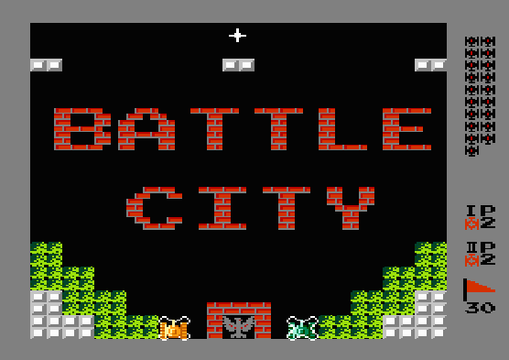
Background
Tank war: 2-D board multi-directional shooter
A Popular Instance: Battle City released in 1985 on FC/NES
Maps (boards) are made of grids on a panel
Arbitrary numbers of players and enemies (cannot overlay)
(We will only involve single player in our project)
What's more...
Player and enemies shoot shells
One side wins if and only if all opponents are dead (or their headquater is destroyed)
A grid can be empty, breakable/unbreakable wall, water (block tanks but not shells), ......
Many open-source game skeletons written in Python
Can be adapted to AI agents easily
https://www.retrogames.cz/play_014-NES.php
Notes:
坦克大战：红白机的经典游戏
地图也是平面网格，玩家和敌人数量任意（我们会专注于单个玩家）

Slide 3
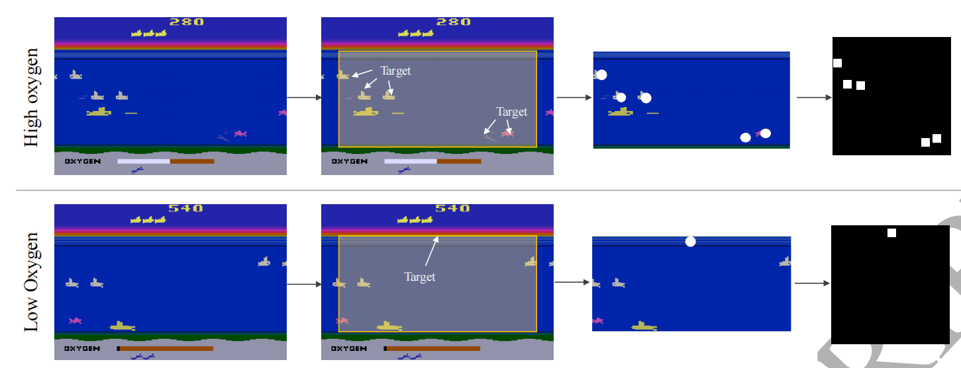
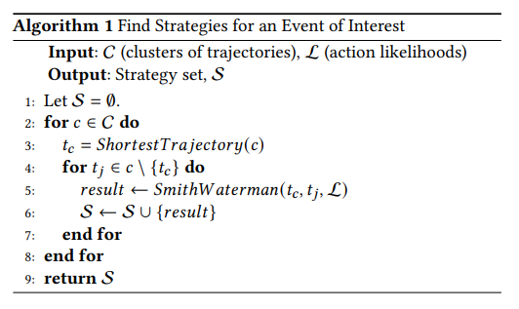
Concepts Mentioned in Some Papers
"Target Map"
Proposed during the training of AI game agent using neural network, it can be considered as an attention mechanism.
Figure: An example of the target map in Atari Seaquest
"Smith-Waterman Algorithm"
View strategy acquisition as a sequential pattern mining task.

Slide 4

Methods Used in Some Papers
Deep reinforcement learning
Conbination of deep learning and reinforce learning.
Self-Play
A method making agent plays games with themselves to improve its performance.
Curriculum Learning
A training method designed to help agent learn more efficiently by gradually increasing the difficulty of training samples.
Multi-Policy Controlling System
Multiple agents are trained at the same time, and each agent corresponds to a different region

Slide 5
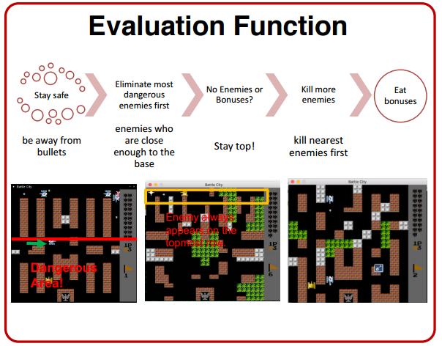
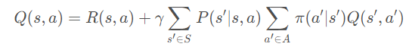
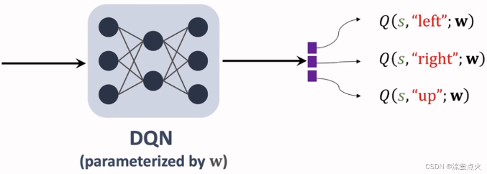

Design Agent
Search-Minimax
Q-learning
State Space， Action Space, Reward;
Off-policy
DQN
Deep Q-network
Random & More
Genetic algorithm, MCTS and so on, as contrasts and exploration
Notes:
off-policy: 可以使用历史数据进行学习，不受实时数据的限制。更容易实现高效的探索，因为行为策略可以专注于探索，而目标策略专注于性能。 Evalustion function 的迭代 DQN: 神经网络的的输入是状态s，输出是对所有动作a的打分

Slide 6
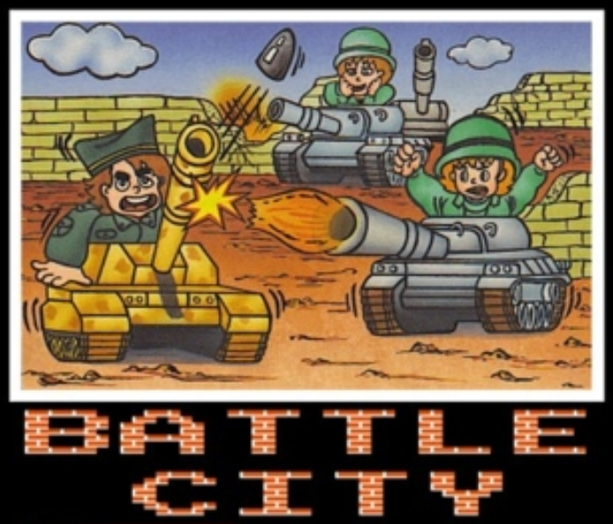
Future & Challenges
Proposed Methods
Baseline：random agent
Search：Expectimax and more
Linear model
then…maybe
Approximate Q-learning
Deep Q Network
We wish…
Prevent overfitting
Compare with human oracle
From a simplified version to a more complex one (close to original…)
Uncertainty
Game setting is not easy at all, hard to model transitions between states.
Number of game state is huge. Huge state space.
Sparse default rewards.

Slide 7
谢谢观看
Proposal report

